Slide 1

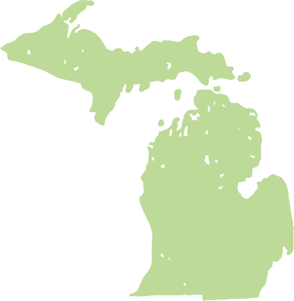
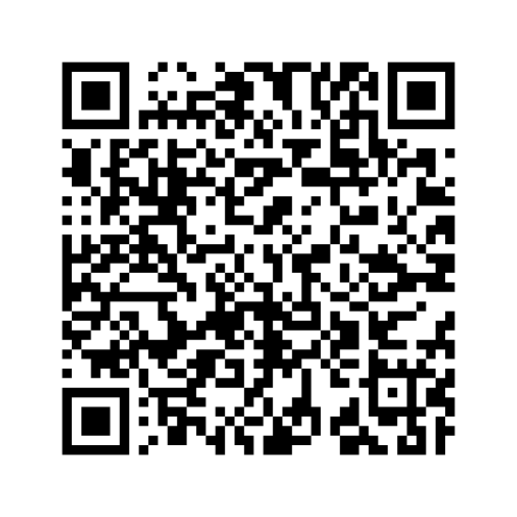

A statewide community science effort inviting volunteers of all experience levels to help track aquatic invasive species in Michigan’s lakes, rivers, and streams by snapping photos with the iNaturalist app.
Notes:
About the MiCorps AIS Detection Blitz:
The MiCorps AIS Detection Blitz is a statewide community science effort using the iNaturalist app to help track aquatic invasive species in Michigan’s lakes, rivers, and streams. This initiative makes it easy for volunteers of all experience levels to participate- just take photos of aquatic plants or species you see while you're out on the water! Observations contribute to a growing dataset that could support early detection and management of invasive species across the state.
Key Points:
The AIS Detection Blitz will be an annual event encouraging volunteers to document aquatic species.
Anyone can participate- no ID skills needed! Simply take photos with the iNaturalist app. Just snap what you find!
The event takes place during the July 4th holiday week when many people are already on the water.
Organizations can spread the word, host group outings, or simply encourage participation.
Follow the QR code or search "MiCorps" within the iNaturalist app to join the project.

